Slide 1
AME20216 - Lab I L5 – Analog Sensors

Slide 2
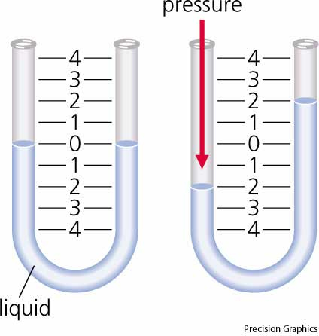
Transducer
Converts a physical stimulus to a length or voltage
Manometer
Pressure
Length
Analog Pressure Sensor
Pressure
Voltage
Analog sensor – outputs a voltage

Slide 3
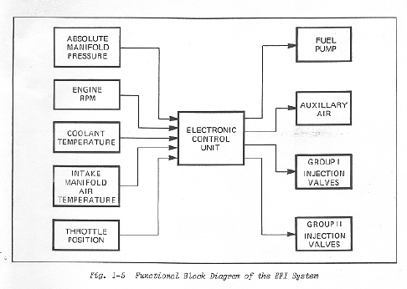
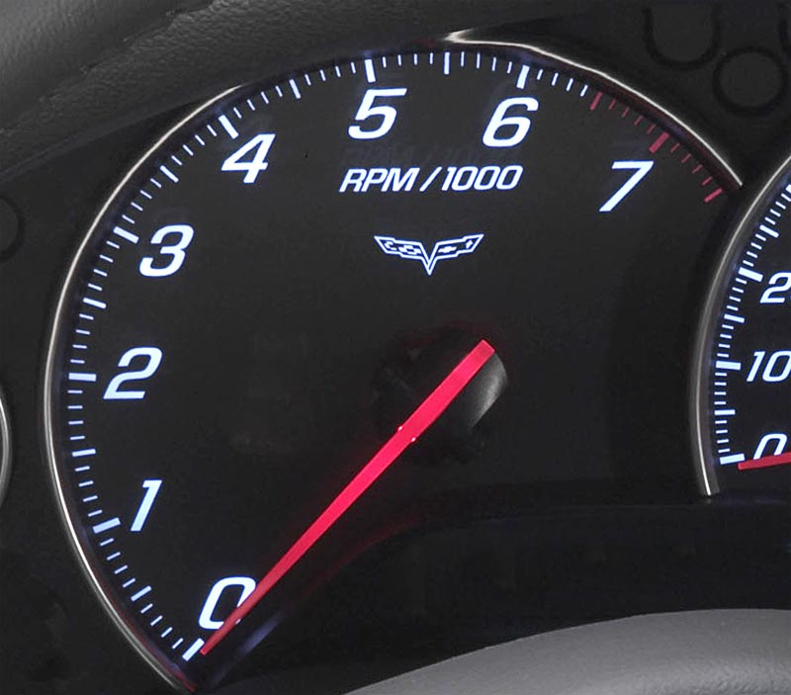
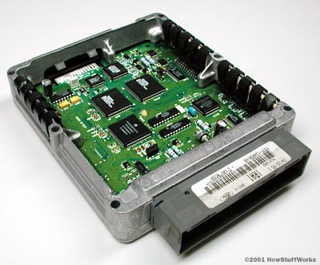
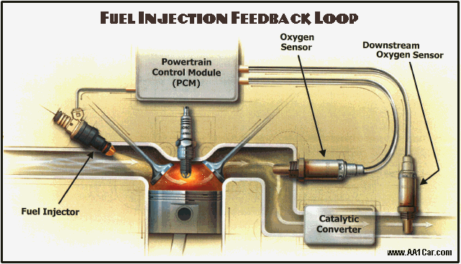
Automotive Electronic Control Unit (ECU)

Slide 4
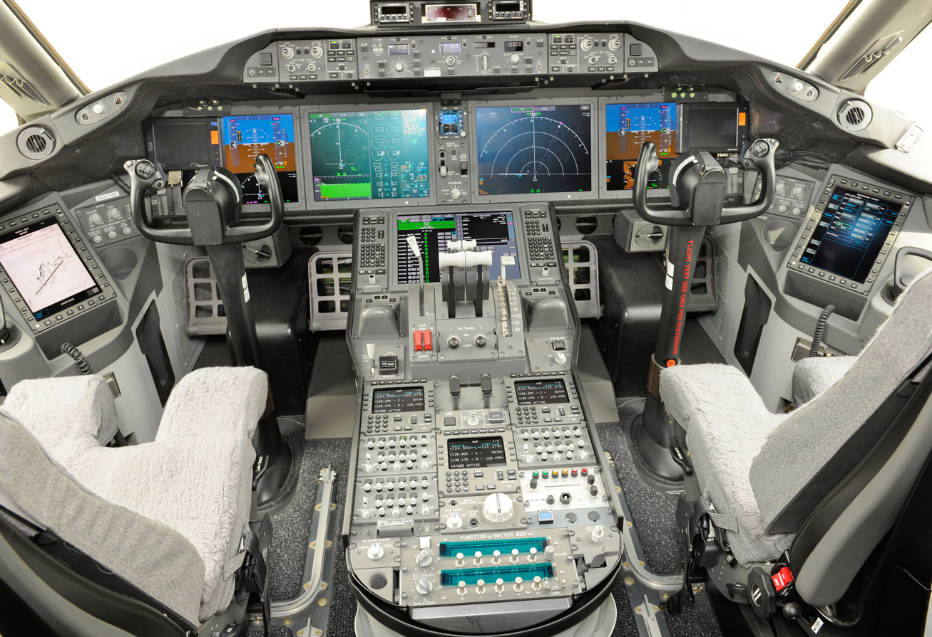
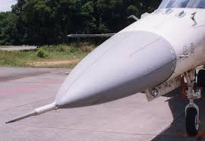
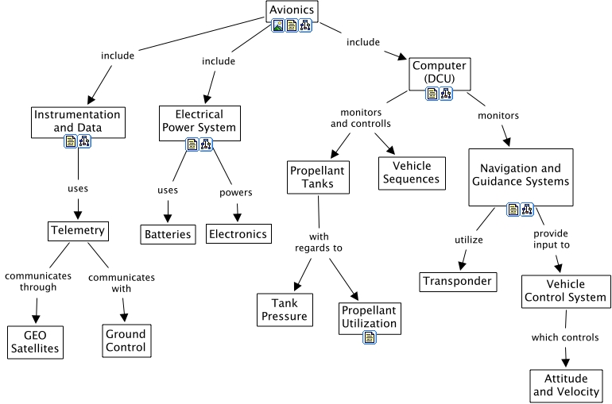
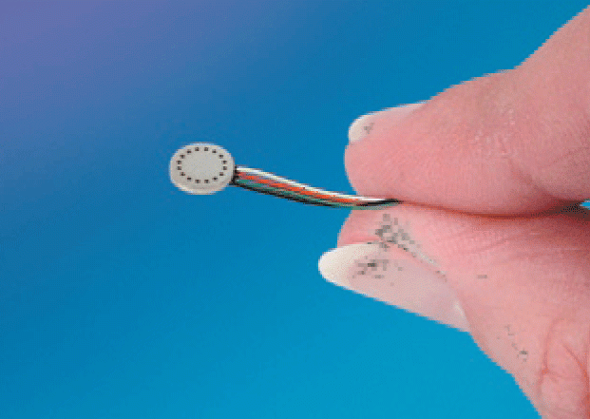
Avionics

Slide 5
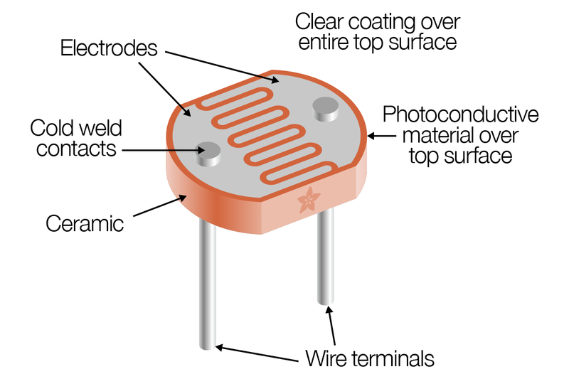
Cadmium Sulfide (CdS) Photocell
Resistance of Photocell changes when illuminated.
Light Intensity
Resistance
Voltage

Slide 6
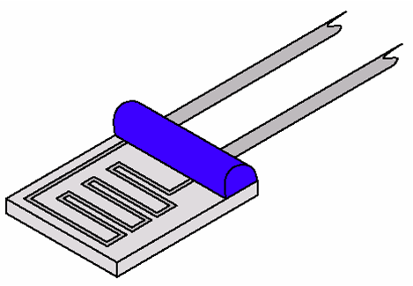
RTD – Resistance Temperature Detector
The resistivity of a metal changes linearly with temperature.
Lab1: Voltage divider circuit

Slide 7
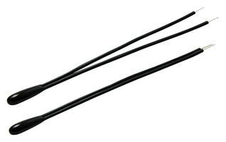
Thermistor
Works the same as an RTD, except the sensing material is made of a ceramic or a semiconductor.
Non-linear response

Slide 8
Thermistor
Thermistor in a Voltage divider
Steinhart Equation
Voltage Divider Equation
Temperature
Resistance
Voltage

Slide 9
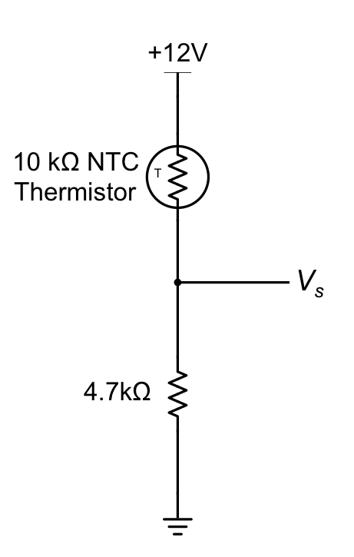
Analog Temperature Sensor
There is a “one-to-one” mapping between temperature and voltage.

Slide 10
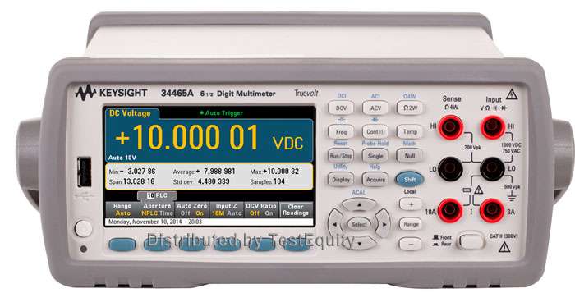
Thermistor
Measure V_{out} with the
Keysight Precision DMM
Temperature
Resistance
Voltage

Slide 11
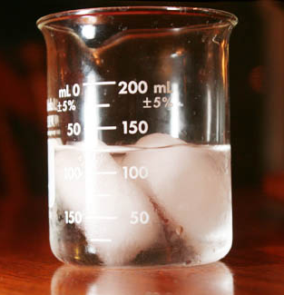
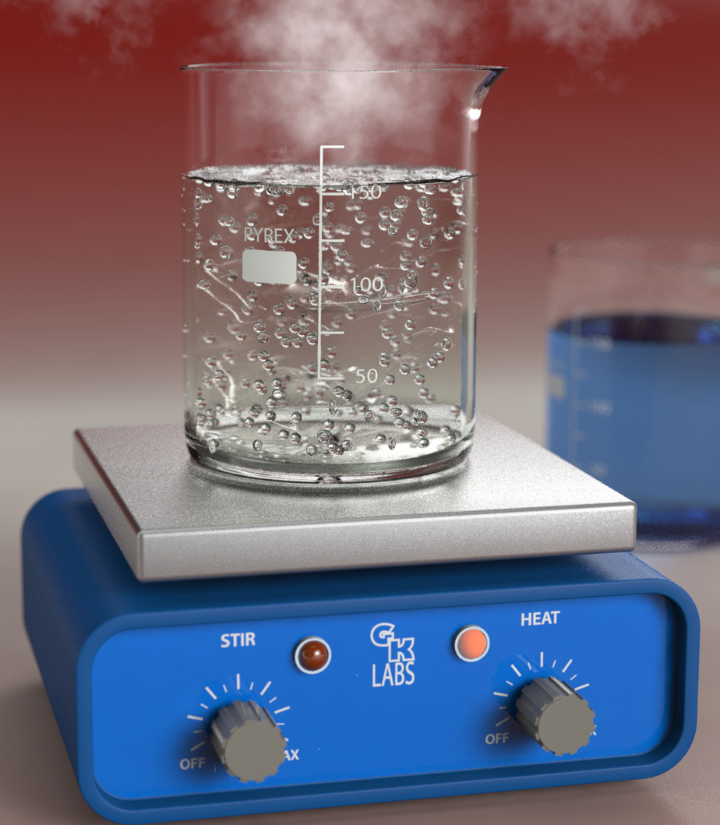
2-point Calibration
Determine the coefficients A and B
ICE BATH
T = 273K
BOILING WATER
T = 373K

